Slide 1
Naïve Bayes Classifier
IST565 Data Mining

Slide 2
Bayes Theorem
What is Bayes Theorem mathematically?
How can computers use Bayes Theorem?

Slide 3
Review of probability concepts
An event is an outcome of an experiment, e.g.
Experiment: toss a fair coin
Possible outcomes: “head” or “tail”.
The probability that either event (“head” or “tail”) occurs is 50%, i.e.:
P(head)=0.5, P(tail)=0.5
P(head) + P(tail) = 1
If the coin is not balanced, then P(head) != P(tail)
Notes:
Probability is a fundamental concept in data science literacy.

Slide 4
Joint probability
Joint probability P(A, B) is the chance that two events A and B co-occurred, e.g.:
Experiment: toss two fair coins
Event A: coin1=“head”
Event B: coin2=“head”
P(A, B) = P(coin1 = “head”, coin2 = “head”)
P(A, B) and P(B, A) are the same thing

Slide 5
Independent events
The occurrence of one event does not depend on the occurrence of the other event
E.g, toss two fair coins, both landed head up
Event A: coin1 = “head”
Event B: coin2 = “head”
P(A, B) = P(A) * P(B) = 0.5 * 0.5 = 0.25

Slide 6
Dependent events
The occurrence of one event is dependent on the occurrence of another event.
E.g. choose a card from a standard deck of 52 cards. Without replacement, choose another card. What is the probability of choosing two queens?
Because the outcome of the second card is dependent on the outcome of the first card, P(card1=“queen”, card2=“queen”) != P(card1=“queen”) * P(card2=“queen”)

Slide 7
Conditional probability
Conditional probability P(B|A)
The probability that event B occurs if event A occurs
Event A: card1=“queen”
Event B: card2=“queen”
P(B|A) = P(card2=“queen” |card1= “queen”) = 3/51, because there are 51 remaining cards and only 3 queens among them.

Slide 8
Relationship between conditional and joint probabilities
P(A, B) = P(A) * P(B|A)
P(card1=“queen”, card2=“queen”) =P(card1=“queen”) * P(card2=“queen”|card2=“queen”) =4/52 * 3/51 =0.5%

Slide 9
Probability is useful in daily life
Which one is greater?
P(“will”|“I”)
P(“has”|“I”)
This is how your smartphone knows what words to recommend when you are texting!
All words that people typed become the training corpus, in which the conditional probabilities are calculated.

Slide 10
Exercise: calculate probability
Choose a card from a standard deck of 52 cards. Without replacement, choose another card. What is the probability P(card1=“queen”, card2=“king”)?
Notes:
4/52*4/51

Slide 11
Chances are…
Read Professor Steven Strogatz’s blog article on New York Times “Chances Are”
http://opinionator.blogs.nytimes.com/2010/04/25/chances-are/
This article explains Bayes Theorem in lay-person’s language

Slide 12
Bayes Theorem
Bayes Theorem lets us swap the order of the dependence between events
Two events A and B
We know that P(A,B) = P(B|A)P(A)
Since P(A, B) = P(B, A),
We also know that P(B, A) = P(B|A)P(A)
Therefore,

Slide 13
Back to the mammogram example in Professor Strogatz’s article
Event A: a patient has cancer
Event B: a patient’s mammogram test result is positive
P(B|A) = Among patients who have cancer, how many have positive test result?
We can calculate it from past data
P(A|B) = For a patient with positive test result, what is the chance of cancer?
This is prediction!
Bayes Theorem provides an approach to predict the probability of future events based on prior experience

Slide 14
The mammogram example
The probability that a woman has breast cancer is ?
If a woman has breast cancer, the probability that she will have a positive mammogram is ?
If a woman does not have breast cancer, the probability that she will still have a positive mammogram is ?

Slide 15
Back to the mammogram example
The probability that a woman has breast cancer is P(cancer) = 0.008
If a woman has breast cancer, the probability that she will have a positive mammogram is P(positive|cancer) = 0.9
If a woman does not have breast cancer, the probability that she will still have a positive mammogram is P(positive|no cancer) = 0.07

Slide 16
Translate them into probability notations
Imagine a woman who has a positive mammogram. What is the probability that she actually has breast cancer?
Which probability is greater, P(cancer|positive) or P(no cancer|positive) ?
To calculate P(cancer | positive), need to calculate
P(positive)
P(cancer)
P(positive | cancer)
To calculate P(no cancer | positive), need to calculate
P(positive)
P(no cancer)
P(positive | no cancer)

Slide 17
Translate them into probability notations
The probability that a woman has positive mammogram is
unknown
The probability that a woman has breast cancer is 0.008
P(cancer) = 0.008 , P(no cancer) = 0.992, (add up to 1)
If a woman has breast cancer, the probability that she will have a positive mammogram is 0.9.
P(positive | cancer) = 0.9
If a woman does not have breast cancer, the probability that she will still have a positive mammogram is 0.07.
P(positive | no cancer) = 0.07

Slide 18
Translate them into probability notations
All prior probabilities we have calculated
P(cancer) = 0.008
P(no cancer) = 0.992
All conditional probabilities we have calculated
P(positive | cancer) = 0.9
P(positive | no cancer) = 0.07
The posterior probabilities to be calculated
P(cancer | positive) = ? P(no cancer | positive) = ?

Slide 19
So, our prediction is …

Slide 20
No cancer!
Although we don’t know P(positive), it does not matter. We just need to know which posterior probability is greater.

Slide 21
This diagnosis is determined by the mammogram result ONLY

Slide 22
What if the diagnosis is determined by more factors than just the mammogram result?
Attribute 1: positive mammogram? Yes or no
Attribute 2: family history? Yes or no
Attribute 3: Alcohol? Yes or no
How many posteriors to calculate?
Two posteriors for each possible combination of the attributes.
In this case, 2* 2³ = 16

Slide 23
All posterior probabilities for three binary attributes

Slide 24
Challenge of Bayesian classifier

Slide 25
Challenge of Bayesian classifier
2^{n+1} possible combinations of values for n binary attributes
Notes:
Text classification

Slide 26
Challenge of Bayesian classifier
2^{n} possible combinations of values for n binary attributes
What if n=10,000? Quite common for text classification when each word is an attribute.
Notes:
Text classification

Slide 27
Challenge of Bayesian classifier
Too many probabilities to calculate!

Slide 28
Challenge of Bayesian classifier
There may not be enough data for accurately estimating each probability.

Slide 29
Naïve Bayes Classifier
Assume independence among attributes A_{i} when class is given:
P(A₁, A₂, …, A_{n} |C) = P(A₁| C_{j}) * P(A₂| C_{j}) *… * P(A_{n}| C_{j})
= Π P(A_{i}| C_{j})
This assumption means that given the target class C, the probability of observing the conjunction A₁A₂A₃…A_{n} is just the product of the probabilities for the individual attributes
For example, for people with cancer, the assumption is whether there is family history of cancer has nothing to do with race, which may or may not be scientifically true.

Slide 30
Why is the independence assumption needed?
Assume independence among attributes A_{i} when class is given:
P(A₁, A₂, …, A_{n} |C) = P(A₁| C_{j}) P(A₂| C_{j})… P(A_{n}| C_{j})
= Π P(A_{i}| C_{j})
To greatly reduce the number of probabilities to estimate

Slide 31
Why is the independence assumption needed?
Reduce calculation
2³ -> 2*3

Slide 32
Similarly,
Reduce calculation
2³ -> 2*3

Slide 33
Similarly,
Reduce calculation
2³ -> 2*3
Total calculation reduction 2*2^{n} → 2*2*n
If n=10, 2048 probabilities reduced to 40!

Slide 34
Why does “naïve” Bayes work?
This assumption is often violated in real-world problems
E.g. Family history of cancer may be correlated with race
However, naïve Bayes algorithm works quite well in many problems, even when the assumption is violated. There are some mathematical explanation for this phenomenon.
Domingos, P. and Pazzani, M. (1997). On the optimality of the simple Bayesian classifier under zero-one loss. Machine Learning, 29: 103–30
What if the correlations between attributes have to be addressed?
Use Bayesian Belief Network (BBN)

Slide 35
Exercise: estimate prior probabilities from training data
Example | Positive mammogram | Family history | alcohol | Cancer
1 | Yes | Yes | Yes | yes
2 | Yes | Yes | No | Yes
3 | No | Yes | yes | Yes
4 | Yes | No | No | No
5 | Yes | No | Yes | No
6 | No | No | Yes | No
7 | No | No | No | No
Given the above training data set:
Calculate prior probability for each class: P(C) = N_{c}/N
P(cancer=yes)=?
P(cancer=no)=?
Notes:
3/7
4/7

Slide 36
Exercise: estimate conditional probabilities from training data
Then calculate the conditional probabilities for each attribute
P(A_{i} | C_{k}) = |A_{ik}|/ N_{c} E.g.
P(pos_mammo=yes | cancer=yes) = ?
P(pos_mammo=no | cancer=yes) = ?
P(pos_mammo=yes | cancer=no) = ?
P(pos_mammo=no | cancer=no) = ?
Notes:
2/3
1/3
2/4
2/4

Slide 37
Exercise: estimate conditional probabilities from training data
Repeat for the “family_history” attribute:
P(family_history=yes | cancer=yes) = ?
P(family_history=no | cancer=yes) = ?
P(family_history=yes | cancer=no) = ?
P(family_history=no | cancer=no) = ?
Notes:
3/3
0/3
0/4
4/4

Slide 38
Exercise: estimate conditional probabilities from training data
Repeat for the “Alcohol” attribute:
P(Alcohol= yes | cancer=yes) = ?
P(Alcohol= no | cancer=yes) = ?
P(Alcohol= yes | cancer=no) = ?
P(Alcohol= no | cancer=no) = ?
Notes:
2/3
1/3
2/4
2/4

Slide 39
Exercise: calculate posterior probabilities
Given a test case (pos_mammo=yes, fam_hist=yes, alcohol=yes), what is the prediction, cancer or no cancer?
P(cancer | pos_mammo=yes, fam_hist=yes, alcohol=yes)
vs.
P(no cancer | pos_mammo=yes, fam_hist=yes, alcohol=yes)

Slide 40
Exercise: calculate posterior probabilities
P(cancer | pos_mammo=yes, fam_hist=yes, alcohol=yes) = P (pos_mammo=yes | cancer) * P (fam_hist=yes | cancer) * P (alcohol=yes | cancer ) * P (cancer) / P (pos_mammo=yes, fam_hist=yes, alcohol=yes) = ( 2/3 * 3/3 * 2/3 * 3/7) / P (pos_mammo=yes, fam_hist=yes, alcohol=yes) = ( 12/63 ) / P (pos_mammo=yes, fam_hist=yes, alcohol=yes)

Slide 41
Exercise: calculate posterior probabilities
Similarly, P(no cancer | pos_mammo=yes, fam_hist=yes, alcohol=yes) = P (pos_mammo=yes | no cancer) * P (fam_hist=yes | no cancer) * P (alcohol=yes | no cancer ) * P (no cancer) / P (pos_mammo=yes, fam_hist=yes, alcohol=yes) = ( 2/4 * 0/4 * 2/4 * 4/7) / P (pos_mammo=yes, fam_hist=yes, alcohol=yes) = ( 0 ) / P (pos_mammo=yes, fam_hist=yes, alcohol=yes)

Slide 42
Exercise: calculate posterior probabilities
Prediction: cancer!
12/63 : 0
Choose the decision with max posterior probability

Slide 43
Problem of zero probability
Similarly, probability of no cancer
Zero probability of no cancer?

Slide 44
Problem of zero probabilities
If one of the conditional probabilities is zero, then the entire product becomes zero.
But the zero prob may just be caused by lacking of data
P(fam_hist=yes | cancer=yes) = 1
P(fam_hist=no | cancer=yes) = 0
P(fam_hist=yes | cancer=no) = 0
P(fam_hist=no | cancer=no) = 1

Slide 45
Solution to zero prob
Probability estimation should replace these zero probabilities with a very small probability, which means such events still occur in real world, but so rare that the training data did not include any of them.
Since all probabilities should add up to one, the other non-zero probabilities need to “shrink” a little bit, in order to “lend” the small amount to the zero probabilities.
Such technique is called “smoothing”

Slide 46
Smoothing for zero probabilities
using a smoothing algorithm, such as Laplace smoothing, or called “add-one” smoothing
A binary classifier has two classes (c=2)

Slide 47
Add-one smoothing
Example | Pos_mammo | Fam_hist | Alcohol | Cancer
1 | Yes | Yes | Yes | yes
2 | Yes | Yes | No | Yes
3 | No | Yes | yes | Yes
4 | Yes | No | No | No
5 | Yes | No | Yes | No
6 | No | No | Yes | No
7 | No | No | No | No
 | Cancer=yes | Cancer=no
Fam_hist=yes | 3 | 0
Fam_hist=no | 0 | 4
 | Cancer=yes | Cancer=no
Fam_hist=yes | 3+1 | 0+1
Fam_hist=no | 0+1 | 4+1
add-one smoothing means to add an example to each category

Slide 48
Add-one smoothing
 | Cancer=yes | Cancer=no
Fam_hist=yes | 3 | 0
Fam_hist=no | 0 | 4
 | Cancer=yes | Cancer=no
Fam_hist=yes | 3+1 | 0+1
Fam_hist=no | 0+1 | 4+1
add-one smoothing means to add an example to each category
Original probabilities:
P(fam_hist=yes | cancer=yes) = 3/3
P(fam_hist=no | cancer=yes) = 0/3 = 0
P(fam_hist=yes | cancer=no) = 0/4 = 0
P(fam_hist=no | cancer=no) = 4/4 = 1
smoothed probabilities:
P(fam_hist=yes | cancer=yes) = 4/5
P(fam_hist=no | cancer=yes) = 1/5
P(fam_hist=yes | cancer=no) = 1/6
P(fam_hist=no | cancer=no) = 5/6
The non-zero probs become smaller, “lending” values to zero probs

Slide 49
Smoothing for zero probabilities
using a smoothing algorithm, such as Laplace smoothing, or called “add-one” smoothing
A binary classifier has two classes (c=2)
Well this is not a very small probability??

Slide 50
Smoothing for zero probabilities
using a smoothing algorithm, such as Laplace smoothing, or called “add-one” smoothing
The probabilities in real-world problems are usually very small, and thus add-one smoothing would change the probability just a little bit.

Slide 51
Log probabilities
The probabilities are so small that we usually use log(P) instead, so that we don’t have to store that many preceding zeros like in 0.000222.

Slide 52
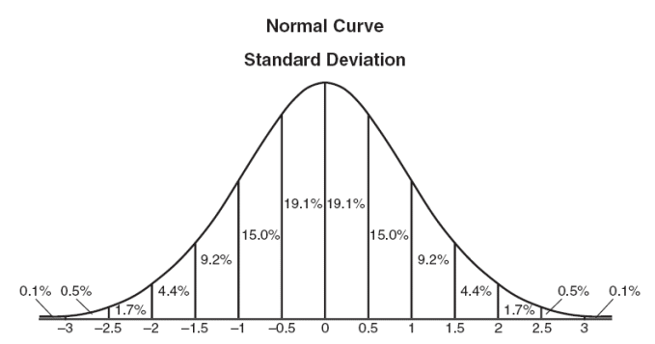
How to Estimate Probabilities of continuous attributes?
Two approaches for continuous attributes:
Discretization
[0,60k), [60k, 100k), [100k, ..)
Probability density estimation:
Assume attribute follows a normal distribution
Use data to estimate parameters of distribution (e.g., mean and standard deviation)
Once probability distribution is known, can use the probability density function to estimate the conditional probability P(A_{i}|c)
k

Slide 53
How to Estimate Probabilities of continuous attributes?
Normal distribution:
One for each (A_{i},c_{i}) pair
For (Income, Class=No):
If Class=No
sample mean = 110
sample variance = 2975
Notes:
If class=no,
Sample mean=(125K+100K+70K+120K+60K+220K+75K)/7=770K/7=110K

Slide 54
How do I know if a variable follows normal distribution?
Approach 1: use statistics test
Approach 2 (recommended to our class) : use visualization (does it look at a bell curve?)

Slide 55
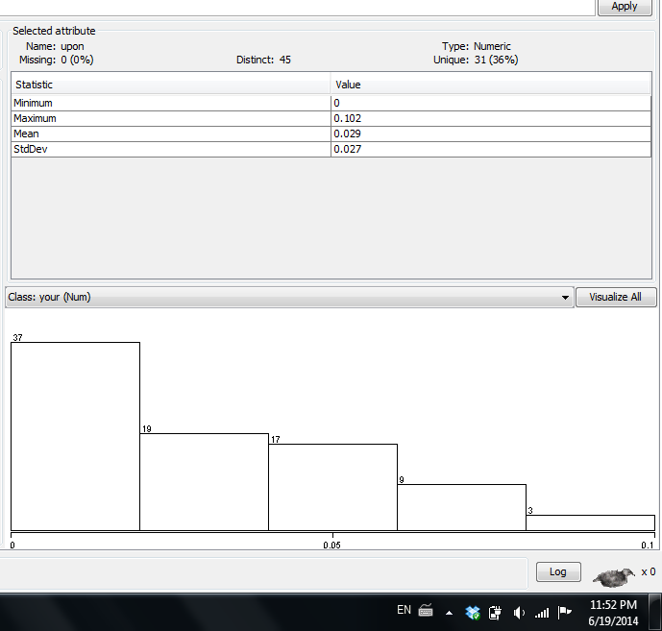
A variable that seems not normal distribution

Slide 56
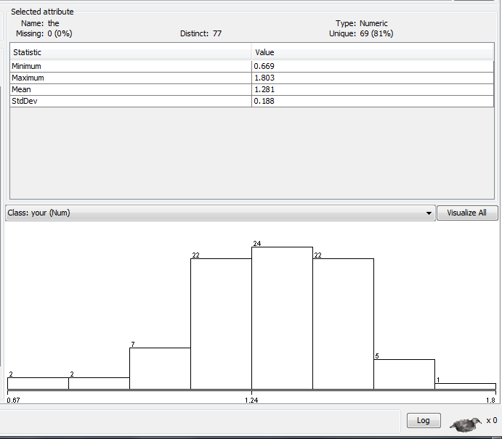
A variable that seems follow normal distribution

Slide 57
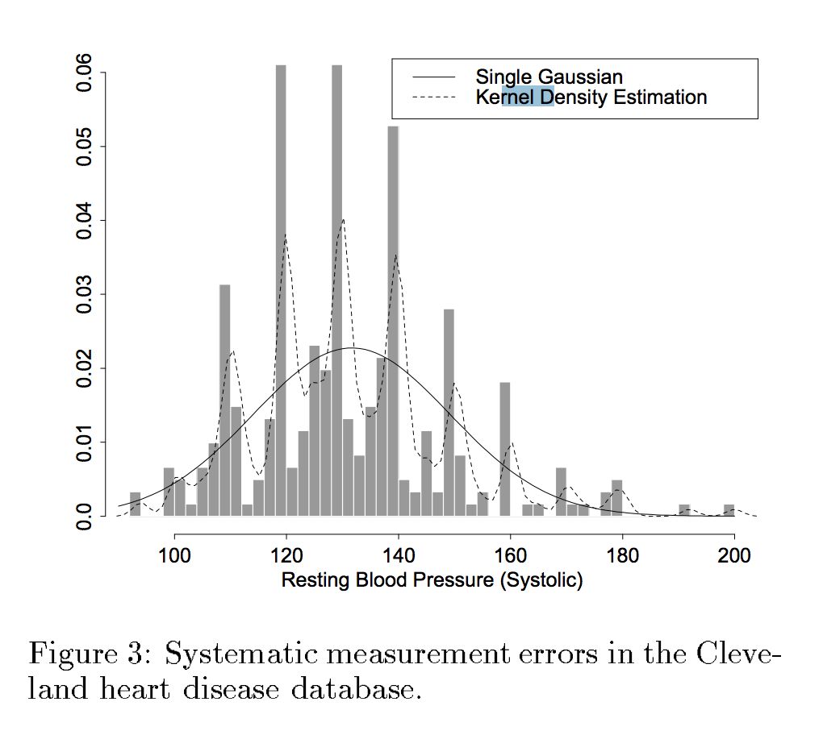
Normal vs. Kernel density estimation
Normal distribution and Gaussian distribution are two names for the same thing
http://www.cs.iastate.edu/~honavar/bayes-continuous.pdf

Slide 58
Build a naïve Bayes classifier
P(refund=No)=7/10, P(refund=yes)=3/10
conditional probability
Prior probability

Slide 59
Use naïve Bayes Classifier for prediction
Given a Test Record, calculate posterior probs, and choose decision with max posterior prob
P(X|Class=No) = P(Refund=No|Class=No) × P(Married| Class=No) × P(Income=120K| Class=No) = 4/7 × 4/7 × 0.0072 = 0.0024
P(Class=No|X) =P(X|Class=No) x P(Class=No) / P(X)

Slide 60
Use naïve Bayes Classifier for prediction
Given a Test Record:
P(X|Class=No) = P(Refund=No|Class=No) × P(Married| Class=No) × P(Income=120K| Class=No) = 4/7 × 4/7 × 0.0072 = 0.0024
P(Class=No|X) =P(X|Class=No) x P(Class=No) / P(X)
P(X|Class=Yes) = P(Refund=No| Class=Yes) × P(Married| Class=Yes) × P(Income=120K| Class=Yes) = 1 × 0 × 1.2 × 10⁻⁹ = 0
P(Class=Yes|X) =P(X|Class=Yes) x P(Class=Yes) / P(X)
Don’t forget smoothing!

Slide 61
Features of Bayesian Learning methods
Each observed training example can incrementally decrease or increase the estimated probability that a hypothesis is correct, and therefore the algorithm is robust to inconsistent examples
Prior knowledge can be combined with observed data to determine the final probability of a hypothesis
E.g. an unbalanced coin 60% chance head 40% tail
Bayesian methods provide probabilistic predictions
E.g. “this pneumonia patient has a 93% chance of complete recovery”

Slide 62
Challenge of Bayesian methods
Practical difficulty
require initial knowledge of many probabilities
Estimate the probabilities when they are unknown
May need to assume normal distribution for continuous variables
Significant cost to compute all probabilities
Specialized assumptions to reduce the computational cost
E.g. naïve Bayes is fast
Independence assumption may not hold for some attributes
Use other techniques such as Bayesian Belief Networks (BBN)
Domingos, P. and Pazzani, M. (1997). On the optimality of the simple Bayesian classifier under zero-one loss. Machine Learning, 29: 103–30
Mitchell, T. (1990). Machine Learning. McGraw-Hill

Slide 63
Exercise: update naïve Bayes model
Assume you have built a naïve Bayes model based on the previous training set in the tax fraud example.
Now, imagine that we have obtained one more training example, and thus need to update the naïve Bayes model.
New example: Refund=No, Married, Income=120K, Evade=Yes
Would you rebuild the model completely, or just update the existing model by re-calculating some probabilities? Show your thought/computation process, and the final, updated naïve Bayes model (including the prior and conditional probabilities).

Slide 64
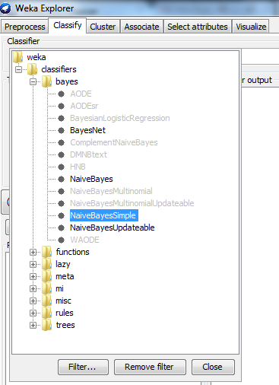
Weka’s implementation of naïve Bayes algorithm
Many different versions of naïve Bayes algorithms.
NaïveBayesSimple
NaïveBayes
NaïveBayesUpdateable
NaïveBayesMultinomial
What are their differences?

Slide 65
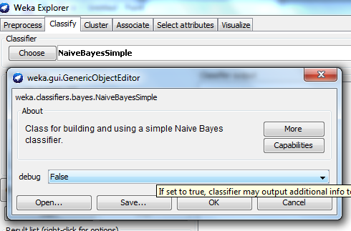
“NaïveBayesSimple”
NaïveBayesSimple assumes all numeric variables follow normal distribution, and thus does not allow discretization. There is no performance-related parameters to tune in this algorithm.

Slide 66
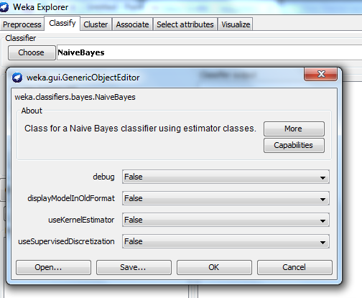
“NaïveBayes”

Slide 67
“NaïveBayes”
“NaïveBayes” allows you to choose from three different methods to handle numeric variables
Method 1: use default parameter setting, assume they follow normal distribution (same as NaïveBayes Simple)
Method 2: turn on the “useKernelEstimator” option to use kernel estimation for numeric variables. The kernel method does not assume normal distribution.
Method 3: turn on “useSupervisedDiscretization” option to discretize numeric variables
Which method to choose?
If your numeric variables follow normal distribution, choose method 1 or NaiveBayesSimple.
Otherwise try the other two methods.

Slide 68
“NaïveBayesUpdateable”
Sometimes training data may trickle in, instead of coming in a batch. It is computationally expensive to re-train the entire model whenever a new training example is added to the training set.
NaïveBayesUpdateable can take new training examples and “update” the existing model without complete retraining.

Slide 69
NaïveBayesMultinomial
This algorithm is particularly designed for text categorization. For implementation details, see supplementary reading “mitchell-nb-text-classifier.pdf”, an excerpt from Tom Mitchell’s textbook on machine learning.

Slide 70
The e1071 package in R
library(e1071)
# https://cran.r-project.org/web/packages/e1071/e1071.pdf

Slide 71
Bayes Theorem in News
MIT Technology Review “How statisticians found Air France Flight 447 two years after it crashed into Atlantic”
http://www.technologyreview.com/view/527506/how-statisticians-found-air-france-flight-447-two-years-after-it-crashed-into-atlantic/
NPR News “Can A 250-Year-Old Mathematical Theorem Find A Missing Plane?
http://www.npr.org/blogs/thetwo-way/2014/03/25/294390476/can-a-250-year-old-mathematical-theorem-find-a-missing-plane

Slide 72
Exercise: naïve Bayes for Kaggle Titanic Prediction
Apply naïve bayes algorithm to the Kaggle Titanic Competition
Report the following experiment setup details to make sure your result is replicable
What pre-processing steps did you do on the data?
What algorithm parameters did you change? If using default parameters, say “default”
What evaluation method did you use? For example, if using CV, specify the number of fold.
Compare naïve Bayes and J48
CV accuracy on the training data

